Slide 1


Slide 2

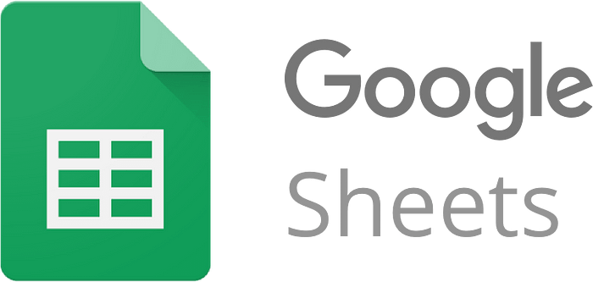



Data Analytics in
Learn how to clean, manipulate, visualize, and analyze data in Spreadsheet
Presented by:
Olusola Ogundepo
Data scientist who leverages advanced analytics to drive business growth while mentoring future leader in data innovation.

Slide 3
Module 4
Data Analysis with PivotTables
Transform raw data into powerful insights using PivotTables, charts, and dashboards in Excel

Slide 4
Why Use PivotTables?
What is a PivotTable?
A PivotTable is an interactive Spreadsheet tool used to quickly summarize large datasets.
Benefits:
Simplifies complex data analysis.
Enables flexible sorting and filtering.
Provides insights through summarization and grouping.

Slide 5
Creating PivotTables
Steps to Create a PivotTable:
Select your data range.
Go to Insert > PivotTable.
Choose a new worksheet or existing location.
Drag fields into Rows, Columns, Values, and Filters areas.
Tip: Ensure your data is structured with headers and no blank rows/columns.

Slide 6
Sorting, Filtering & Summarizing in PivotTables
Sorting Data:
Sort values alphabetically or numerically in rows or columns.
Filtering Data:
Use the Filter or Slicer to refine your view.
Summarizing Data:
Sum, Count, Average, Max, Min, etc., based on numeric fields.
Change aggregation function via Value Field Settings.

Slide 7
Using Calculated Fields
What is a Calculated Field?
A custom field derived from existing data fields using formulas.
Example:
Profit = Sales – Cost
Steps:
Select the PivotTable
Go to PivotTable Analyze > Fields, Items, & Sets > Calculated Field
Define formula and click OK.

Slide 8
Introduction to Charting Techniques
Basic Excel Charts:
Bar Charts – Compare categorical data.
Line Charts – Show trends over time.
Pie Charts – Show proportions of a whole.
Scatter Plots – Show correlation between variables.
Chart Best Practices:
Choose the right chart type for your data.
Use colors to differentiate categories clearly.

Slide 9
Formatting Charts for Better Visualisation
Chart Enhancements:
Add clear titles and labels.
Include legends to identify categories.
Format axes for readability.
Steps:
Click on the chart.
Use Chart Design and Format tabs for styling.

Slide 10
PivotCharts – Visualizing PivotTables
What is a PivotChart?
A dynamic chart that visualizes PivotTable data.
Automatically updates when the PivotTable changes.
How to Create:
Select your PivotTable.
Go to Insert > PivotChart.
Choose the chart type and customize.

Slide 11
Designing Dashboards in Excel
What is a Dashboard?
A visual interface that displays key data insights at a glance.
Dashboard Components:
PivotTables
PivotCharts
Slicers
Interactive controls (buttons, dropdowns)
Design Tips:
Keep it clean and user-friendly.
Group related visuals logically.
Use color coding sparingly and purposefully.

Slide 12
Slicers and Interactive Elements
What are Slicers?
Visual filters that make it easy to interact with data in PivotTables and PivotCharts.
How to Add Slicers:
Click on a PivotTable.
Go to PivotTable Analyze > Insert Slicer.
Select the fields to slice by.
Benefits:
Enables dynamic filtering with a single click.
Improves user interactivity in dashboards.

Slide 13
Storytelling with Data
Why Storytelling Matters:
Helps audiences connect with your data.
Converts analysis into action.
Makes presentations more persuasive and memorable.
Best Practices:
Know your audience.
Highlight key insights—don’t overwhelm with numbers.
Use charts and visuals to reinforce your narrative.
Maintain logical flow: Introduction → Insights → Implications → Action.

Slide 14
Key Takeaways
PivotTables and PivotCharts turn raw data into insights.
Dashboards offer a concise view of performance indicators.
Effective storytelling improves decision-making and communication.

Slide 15
Next:
CAPSTONE PROJECT

Slide 16
Questions?
Get clarity to your doubts and be on good standing

